Slide 1
Project Title Super Store Sales Analysis
Name - Dipan Basak

Slide 2

PROBLEM STATEMENT
The objective of this analysis is to optimize the operations and strategic decision-making of a retail superstore by identifying key sales and profit drivers. The superstore faces challenges in understanding the impact of different factors such as discount rates, product categories, shipping methods, and regional performances on its overall profitability. Identifying these drivers is crucial to enhance profitability, streamline operations, and target marketing efforts more effectively.

Slide 3

Project Description
This project involves a comprehensive analysis of the superstore's sales data to uncover insights and trends that can drive better business decisions. The dataset includes transaction details such as sales, profit, discount, product categories, and customer segments. Key analyses include:
Sales and profit breakdown by product categories, sub-categories, and regions.
Impact of discounts on profitability.
Performance comparison across different customer segments and shipping modes.
Identification of the most and least profitable states.
The analysis aims to provide actionable recommendations to improve sales strategies, inventory management, and customer targeting to ultimately enhance the store’s profitability.

Slide 4

WHO ARE THE END USERS?
Store Management: To make informed decisions on inventory, pricing, and discount strategies.
Marketing Teams: To develop targeted marketing campaigns based on customer segment performance.
Sales Teams: To focus on high-performing products and regions to maximize sales.
Financial Analysts: To understand the financial health and profitability drivers of the store.
Supply Chain Managers: To optimize logistics and shipping methods for cost efficiency.

Slide 5

Technology Used
The following technologies and tools are used in this project:
Python: For data manipulation and analysis using libraries such as pandas and numpy.
VS Code & Google Colab: For interactive data analysis and visualization.
Matplotlib and Seaborn: For creating detailed and informative visualizations.
Pandas: For data cleaning, transformation, and aggregation.
NumPy: For numerical operations and handling large datasets efficiently.
Excel: For initial data storage and manual data examination.

Slide 6
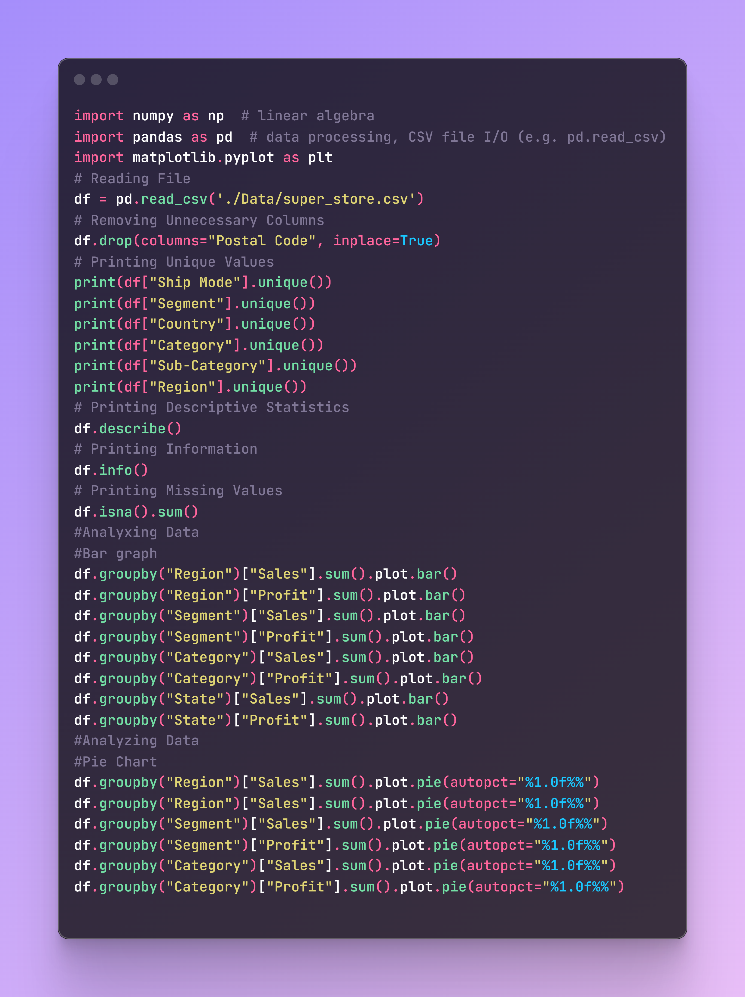
RESULTS
Colab Link - https://colab.research.google.com/drive/1u55sgd6UzDjVwPGaed9nc_L5fvF_1UaY?usp=sharing

Slide 7
Thank you

